Slide 1

Data
Mining
Mr Butler | Digital Technology

Slide 2
explain what is meant by data mining;
describe how digital technology can be used in data mining to gather, store, process and analyse large volumes of data.
explain the importance of big data to the operation and competitiveness of organisations in the
  Health sector
  Finance sector
  Retail sector;
describe the threats to the privacy of the individual from the use of data mining;
What Do We Need To Know?

Slide 3
What is Data Mining?
Data mining involves analysing/sorting large data sets/big data to identify patterns/relationships to predict future trends.
  It is how we analyse big data
It combines the application of AI, statistics and database systems in the analysis of groups of structured and unstructured data sets which prove difficult to analyse using traditional means.
The main aim of data mining is to extract information from a data set and transform it into an appropriate format for future use.
  Patterns are then presented as a summary of the input data and can be used for further analysis
    e.g. they may be input into decision support systems to support predictions for the future

Slide 4

What is Big Data?
Big data is a term associated with data sets that are so complex that traditional database (such as RDBMS’s) and other processing applications are unable to capture, curate (the process of organising data from a range of data sources), manage and process them within an acceptable time frame.
Big data challenges can be defined as the 3V’s:-
  • Volume – the amount of data to be processed
  • Variety – the number of types of data to be analysed
  • Velocity – the speed of data processing
VOLUME
VELOCITY
VARIETY

Slide 5




Volume
Within the Social Media space for example, Volume refers to the amount of data generated through websites, portals and online applications.
Consider the following:
Every day, these users contribute to billions of images, posts, videos, tweets etc. You can now imagine the insanely large amount -or Volume- of data that is generated every minute and every hour.
VOLUME
Amount of data generated
Online & offline transactions
In kilobytes or terabytes
Saved in records, tables, files
3 Billion Users
2.7 Billion Users
VELOCITY
Speed of generating data
Generated in real time
Online and offline data
In streams, batches or bits
556 Million Users
2.4 Billion Active Users
VARIETY
Structured & unstructured
Online images & videos
Human generated – texts
Machine generated - readings

Slide 6

Velocity
With Velocity we refer to the speed with which data are being generated.
Staying with our social media example;
This is like a nuclear data explosion.
Big Data helps the company to hold this explosion, accept the incoming flow of data and at the same time process it fast so that it does not create bottlenecks.
VOLUME
Amount of data generated
Online & offline transactions
In kilobytes or terabytes
Saved in records, tables, files
350 Million photos uploaded daily
1 Billion Hours watched, 3.7 Million videos posted
VELOCITY
Speed of generating data
Generated in real time
Online and offline data
In streams, batches or bits
500 Million Tweets sent daily
8.5 Billion searches daily
VARIETY
Structured & unstructured
Online images & videos
Human generated – texts
Machine generated - readings

Slide 7
Variety
Variety in Big Data refers to all the structured and unstructured data that has the possibility of getting generated either by humans or by machines.
The most commonly added data are structured
  texts
  tweets
  pictures
  videos
However, unstructured data like
  emails
  voicemails
  hand-written text
  ECG reading
  audio recordings etc
are also important elements under Variety.
Variety is all about the ability to classify the incoming data into various categories.
VOLUME
Amount of data generated
Online & offline transactions
In kilobytes or terabytes
Saved in records, tables, files
VELOCITY
Speed of generating data
Generated in real time
Online and offline data
In streams, batches or bits
VARIETY
Structured & unstructured
Online images & videos
Human generated – texts
Machine generated - readings
Notes:
ECG: electrocardiogram

Slide 8
Big Data Gathering?
Consumer goods companies actively scan social media websites to decipher user preferences, choices and perceptions towards their brands.
  Retailers, healthcare organisations, financial services companies all now utilise social media for brand building.
We have more and more data available to use today and data sets grow rapidly, mainly due to the increase in the use of
  mobile phones,
  sensing devices,
  software logs,
  cameras,
  RFID readers and other similar technologies.
Digital technology allows us to collect data for further analysis using methods such as
  online forms,
  mobile phone data transmissions,
  email data,
  stock market data,
  market research,
  personal digital assistants,
  smart phones,
  tablets,
  net-books and many other such technologies.

Slide 9
Big Data Gathering?
Data sources can be categorised into internal and external.
In essence, the commonly used data sources are:
  Social media
  machine data – data generated from devices such as RFID chip readers, GPS results
  transactional data – data generated from companies such as eBay, amazon large stores such as Tesco’s
Internal Data Sources
External Data Sources
customer details,
product details,
sales data etc.
data collected from business partners,
data suppliers, internet,
government and
market research companies.

Slide 10
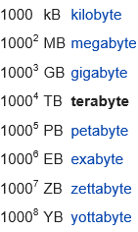
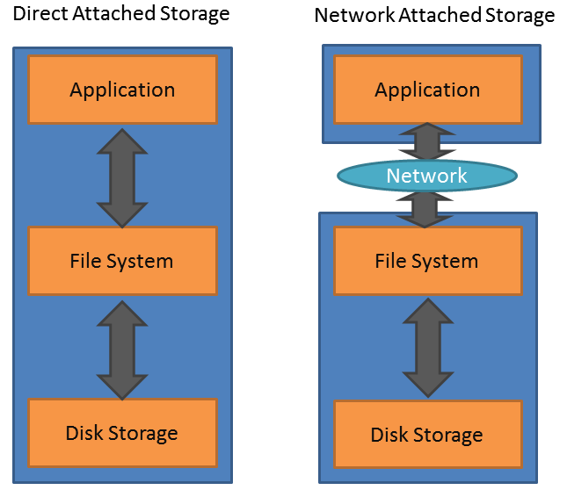
Big Data Storage?
For many organisations the term big data relates to the need to store data sets in the cumulative range of terabytes to many petabytes of data.
The key requirements of big data storage therefore are that it can handle very large amounts of data and keep scaling to keep up with the growth of data sets in addition to being able to provide high speed Input/Output operations necessary to support the delivery of data analytics as they are carried out.
Big data practitioners such as Google, Facebook etc all run what are known as hyperscale computing environments which consist a vast number of servers with Direct Attached Storage (DAS)
Smaller organisations can support the storage of big data through the use of clustered Network Attached Storage (NAS) devices. This is file access shared storage which can easily be scaled out to meet the increased capacity or computing requirements required for big data analysis.
  As NAS systems scale outwards they can be difficult to manage as they tend to span out in a hierarchical manner (many devices with many folders within folders).
  Object-based storage systems offer an alternative to NAS devices and the problems it can lead to. Each file stored in a object-based storage system will be given its own unique identifier and index to support high speed access to a particular data file or data set.
Create a table comparing the NAS and DAS storage types (with Pros/Cons)

Slide 11
Big Data Processing and Analysis
Cluster analysis
– where groups of data records are identified
Classification
– where the data mining process is used to determine an appropriate structure to new data, much in the way for example an email application may classify some emails as spam
Anomaly detection
– where unusual records are identified. Such anomalies may merit further investigation as a point of interest to the organisation or they may be representative of data errors
Association rule mining and sequential pattern mining
– where dependencies between data items can be identified, for example the use of data sets by a supermarket to determine which patterns of products are purchased together
Regression
– where relationships between data variables are investigated to help how a change in an independent variable can impact upon a dependant data variable
Summarisation
–where data is summarised in a visual format
Sims (attendance)
e.g. bank fraud, a structural defect, medical problems or errors in a text
Notes:
2 bullet points from each link

Slide 12
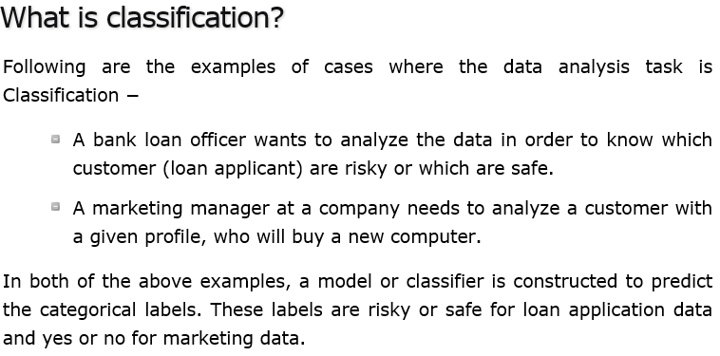

Slide 13
Big Data: Finance Sector
Data is collected continually about each of us by members of the financial sector; when we become customers of a bank, when we telephone a call centre or make financial transactions of any kind for example.
Customers no longer need to visit branches to withdraw or deposit money or even make investments, purchases are made with debit or credit cards and even through mobile devices.
Each interaction generates data and since customer profiles and transactions change rapidly, financial organisations need a reliable means of analysing data.
Many banks now even make use of social media interactions to gauge customers feedback on new products or TV advertisements.

Slide 14
Big Data: Finance Sector
The financial sector includes banking services and even life and general insurance services and have been actively using big data platforms over the past few years with some of their key objectives being:
Ensuring they are complying with regulations
using traditional data processing platforms to support this objective has become increasingly expensive and unsustainable.
For example rather than using traditional means to check customer names and aliases against a customer blacklist, complex fuzzy matching can be applied on name matching and contact information across much larger data sets at a much lower cost.
Improving risk analysis
complex algorithms can be run on large volumes of transaction data to help identify fraudulent activity or to perform risk analysis.
Live data streams can be processed to support trading decisions and to support trending and forecasting on the stock market for example
Understanding customer behaviour and transaction patterns
customer data can be consolidated from a variety of sources and analysed to predict customer spending, mortgage defaults
Improving Services
customer data can be analysed to help identify patterns which can lead to customer dissatisfaction.
Email content, telephone call recordings and social media comments can be analysed to determine positive / negative feelings of customers towards products on offer by the organisation.

Slide 15

How the health sector uses big data
Big data in healthcare is being used to predict epidemics, cure disease, improve quality of life and avoid preventable deaths.
  More and more data is being collected about patients and can be used to help pick up early warning signs of serious illness at stage when treatment may be simpler and cheaper than if it had not been spotted until later.
Smart phones which enable us to measure steps walked, diet and sleep patterns can now also allow us to upload our data for compilation and tracking against other users.
In the near future you would anticipate being able to share this data with your GP who can use it as part of their diagnostic toolbox to support diagnosis.
Big Data: Health Sector

Slide 16
Some health organisations take data from various sources (health and insurance records, sensors worn by the individual, genetic data and even social media content) and use it to tailor health care programs for their clients.
  Such a high volume of data can also be analysed alongside other clients to help identify health patterns and threats using sophisticated modelling processes while on an individual level the treatment programmes can be developed based on reliable and real-time data collected with regards the patients genetic makeup and lifestyle.
The way we visit and interact with doctors is also likely to change in the future.
  Telemedicine allows patients to receive treatment remotely using internet connections.
  All of these interactions leave a data trail which can be analysed to provide insight into trends in health and healthcare provision.
Big data can also be used to support clinical trials to allow researchers to select the best subjects.
  Data sharing arrangements following medical trials can even be used to support breakthroughs in cures for illness
  mobile phone location data was used to track population movement and predict the spread of the Ebola virus in Africa a number of years ago,
  thus providing medical care providers with insight into the best areas to locate treatment centres and to support.
Big Data: Health Sector

Slide 17
Big Data: Retail Sector
Retail organisations are using big data to help understand customer’s behaviour and in an attempt to match customer needs to product made available by the retail store. Big data is applied at every stage of the retail process and can be used to predict trends, forecast demand, price optimising and identifying those customers most likely to be interested in new products.
Predicting trends and forecasting demand
  retailers today make use of a wide range of tools to help identify trends in products.
  Trend forecasting algorithms comb social media posts and ad-buying data is analysed to help determine what products will be pushed forward by marketing organisations.
Price optimisation
  Once there is an understanding of the products people are interested in buying retailers are able to use big data to determine where the demand will be.
  Through the analysis of demographic data and economic indicators spending habits of customers can be identified while algorithms which track millions of transactions every day can be used to track demand against inventory and competitor activity to ensure a retailer can respond quickly to real time changes in market activity
Identifying potential customer
  Data collected through transactional records and loyalty programs allow demand to be forecast around geographic areas

Slide 18
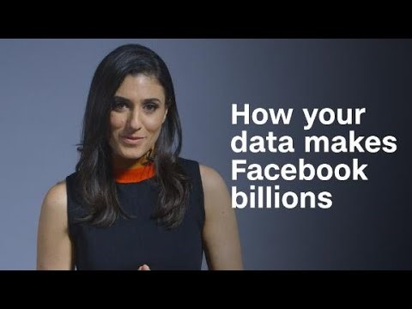
Notes:
https://www.youtube.com/watch?v=vyRsarL-dqk

